Slide 1
Unit Test And DCAF
Notes:
based on materials by M. Ernst, S. Reges, D. Notkin, R. Mercer, Wikipedia

Slide 2
Agenda
Introduction to Unit Test
Why do we need to unit test
What to test
Problems with testing
Test Driven Design
LabVIEW Unit Test Framework
DCAF Unit test
General Guidelines and Tips
Notes:
The pruspose of this session is to give a quick introduction to unit test, as well as how it is applied in DCAF.

Slide 3
Introduction to Unit Test

Slide 4
Unit Test – Do I Need It?
Do I ever make a mistake?
Do my colleagues?
Really?
No
No
Yes
Yes
YES
Notes:
Some of you may not be sold, so I offer you this handy flow chart to determine if your project can benefit from Unit Test.
We’ve all been there at some point, “branching” our code and saving copies by renaming zip files; we’ve all experienced the frustration and potential for accidently modifying the wrong files when using this method. Overall, we should all recognize that it’s very very bad.
For more details on source code control in LabVIEW, please see Eli Kerry’s Software Engineering Technical Manual and Exercises for LabVIEW: https://decibel.ni.com/content/docs/DOC-10122

Slide 5
So why people don’t use it
Perception by some developers and managers:
Testing is seen as a novice's job.
Assigned to the least experienced team members.
Done as an afterthought (if at all).
"My code is good; it won't have bugs. I don't need to test it."
"I'll just find the bugs by running the client program."
Limitations of what testing can show you:
It is impossible to completely test a system.
Testing does not always directly reveal the actual bugs in the code.
Testing does not prove the absence of errors in software.

Slide 6
Unit Test and Flossing
People don't know how to do it correctly (and doing it incorrectly was painful)
People aren't using the right tools for the job (wrapping floss around their fingers when they could use a simple flossing stick)
People don't believe that they have enough time to do it (it doesn't fit their workflow)
Notes:
http://www.labviewcraftsmen.com/blog/do-you-unit-test

Slide 7
What is a Unit Test
Unit Testing: Looking for errors in a subsystem in isolation.
Integration Testing: Looking for errors when 2 or more subsystems are working together.
System Test: Looking for errors ALL the components in the final configuration including integration with other software and hardware.
Notes:
Generally a "subsystem" means a particular class or object.

Slide 8
Why to Do Unit Test
Make sure the blocks works before looking at the system.
Find Bugs Early
Regression testing

Slide 9
Test-driven development
Unit tests can be written after, during, or even before coding.
test-driven development: Write tests, then write code to pass them.
Write code to test this method before it has been written.
Then once we do implement the method, we'll know if it works.

Slide 10
What should we test
Everything????
Nothing
Public APIs

Slide 11
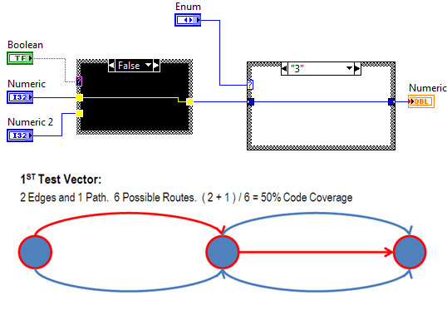
Code Coverage

Slide 12
Regression testing
regression: When a feature that used to work, no longer works.
Likely to happen when code changes and grows over time.
A new feature/fix can cause a new bug or reintroduce an old bug.
regression testing: Re-executing prior unit tests after a change.
Often done by scripts during automated testing.
Used to ensure that old fixed bugs are still fixed.
Gives your app a minimum level of working functionality.
Many products have a set of mandatory check-in tests that must pass before code can be added to a source code repository.

Slide 13
Demo
Notes:
Demo Create a Stump or code to call and test our code.
Create a test VI.
Compare value to expected value
Explain Set Up and Tear down.

Slide 14
What do we need to test?
Requirements
Time
Automation

Slide 15
Unit Test Frameworks

Slide 16
Automation - Test
Source control providers include hooks to continuous integration services
Automatically run all build/test operations on every commit
Track unit test results to a particular commit of files
Make sure that you didn’t break it
Require commit to pass all tests before it can be merged
Prevents one developer’s mistake from hurting everyone
Don’t be that guy

Slide 17
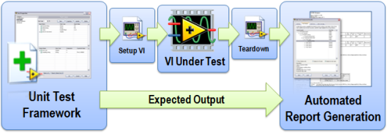
LabVIEW Unit Test
Notes:
http://www.ni.com/white-paper/8082/en/

Slide 18
Demo 2
Notes:
1 Create a Unit Test for Our VI
2 create a Unit Test based on the Demo 1 test VI.

Slide 19
Other Unit Test Frameworks.
JKI Caraya
JKI VI Tester.
Notes:
JKI VI Tester
JKI Caraya

Slide 20
Unit Test In DCAF

Slide 21
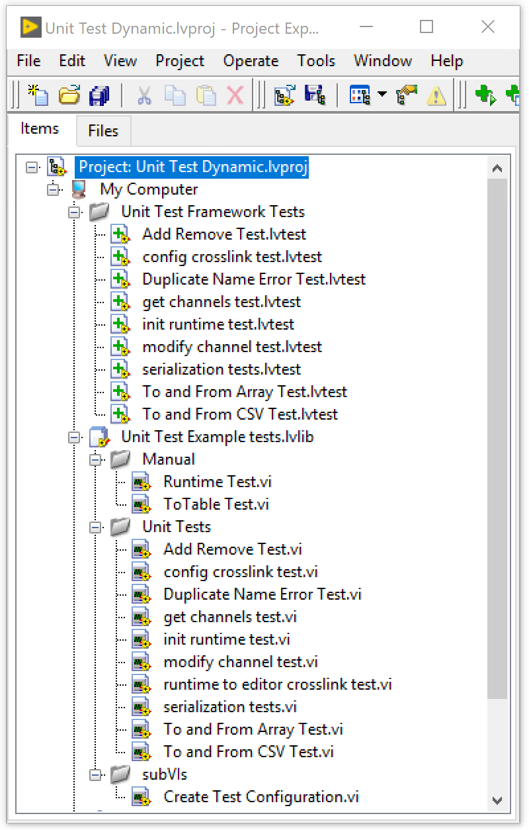
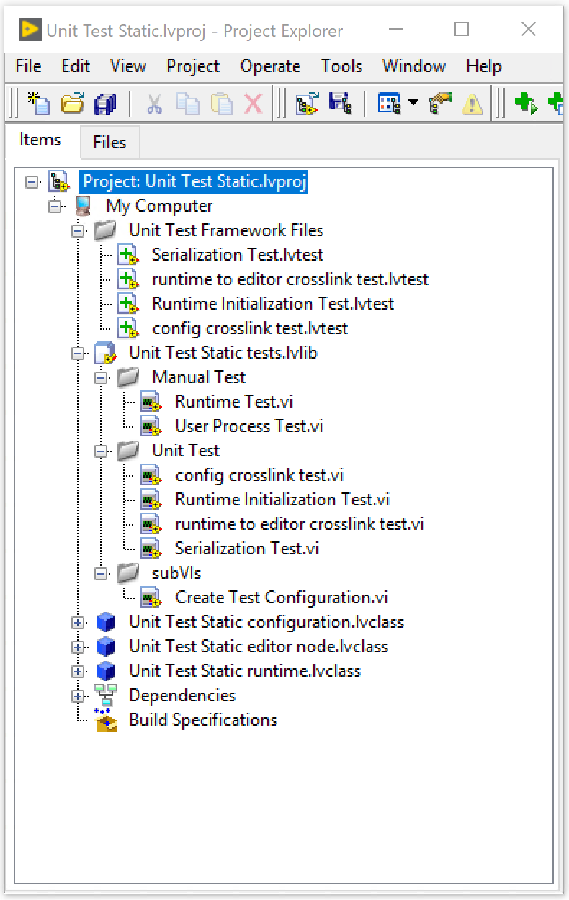
Unit Test In DCAF
Notes:
Templates already include some unit test that you can modify we are going to cover some of the most common ones as well as explain what we are doing .

Slide 22
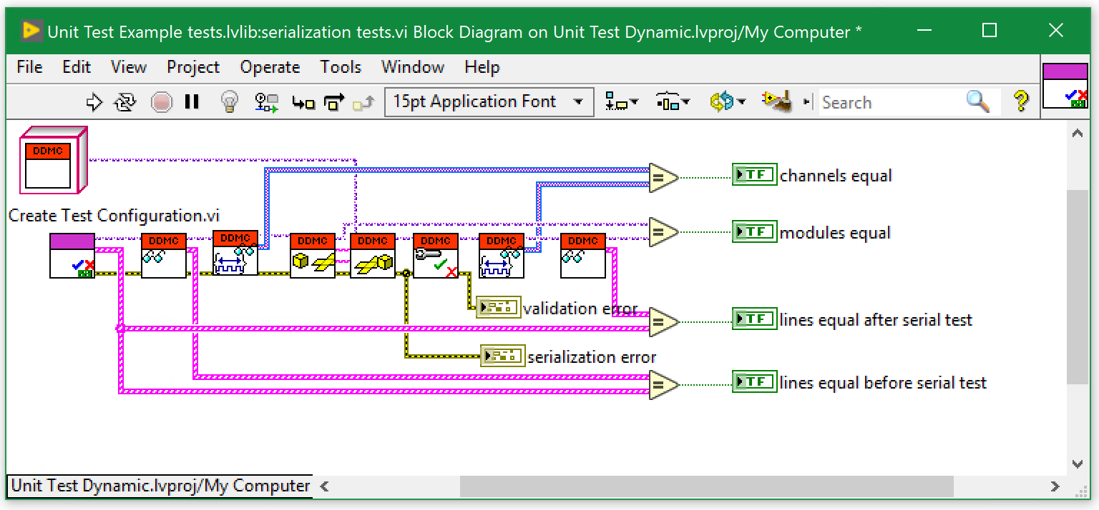
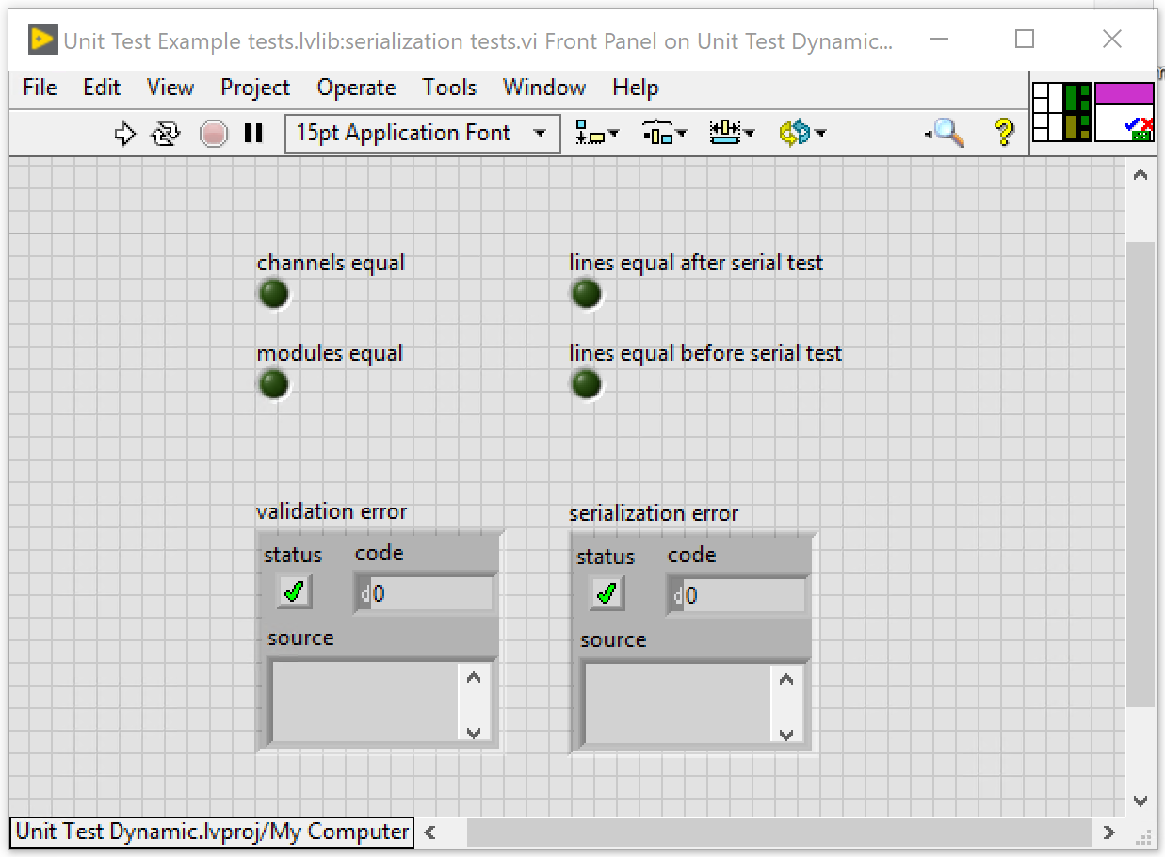
Serialization Test

Slide 23
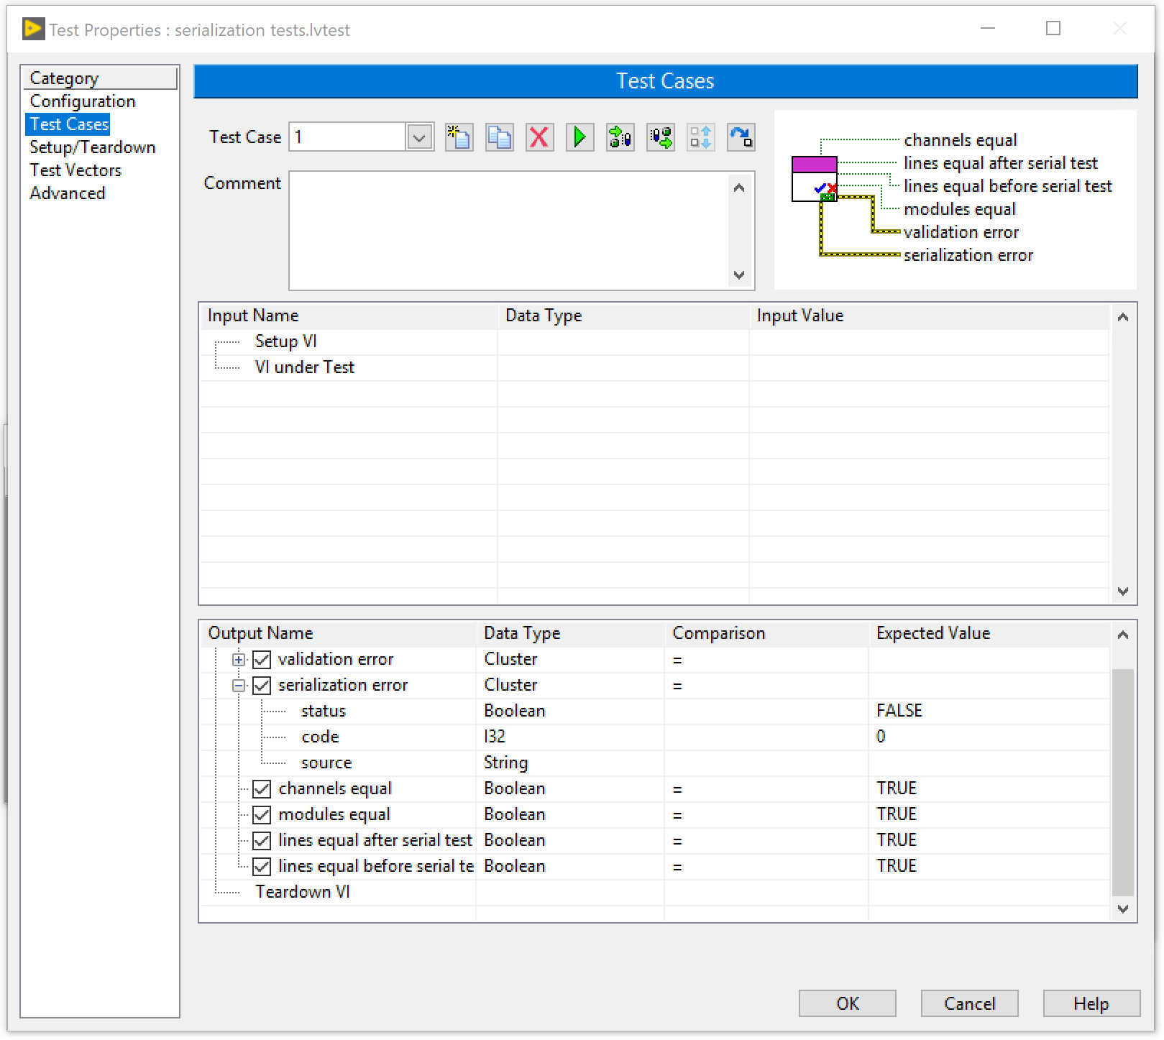
Serialization Test

Slide 24
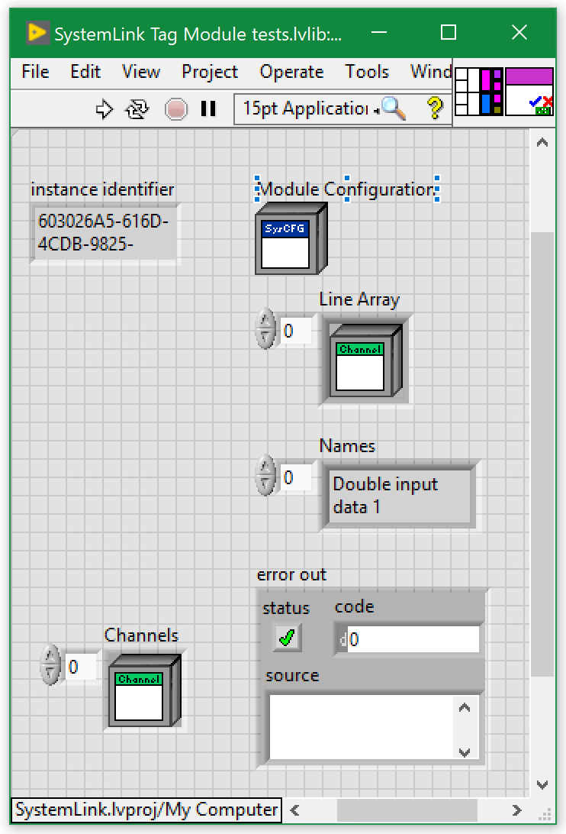
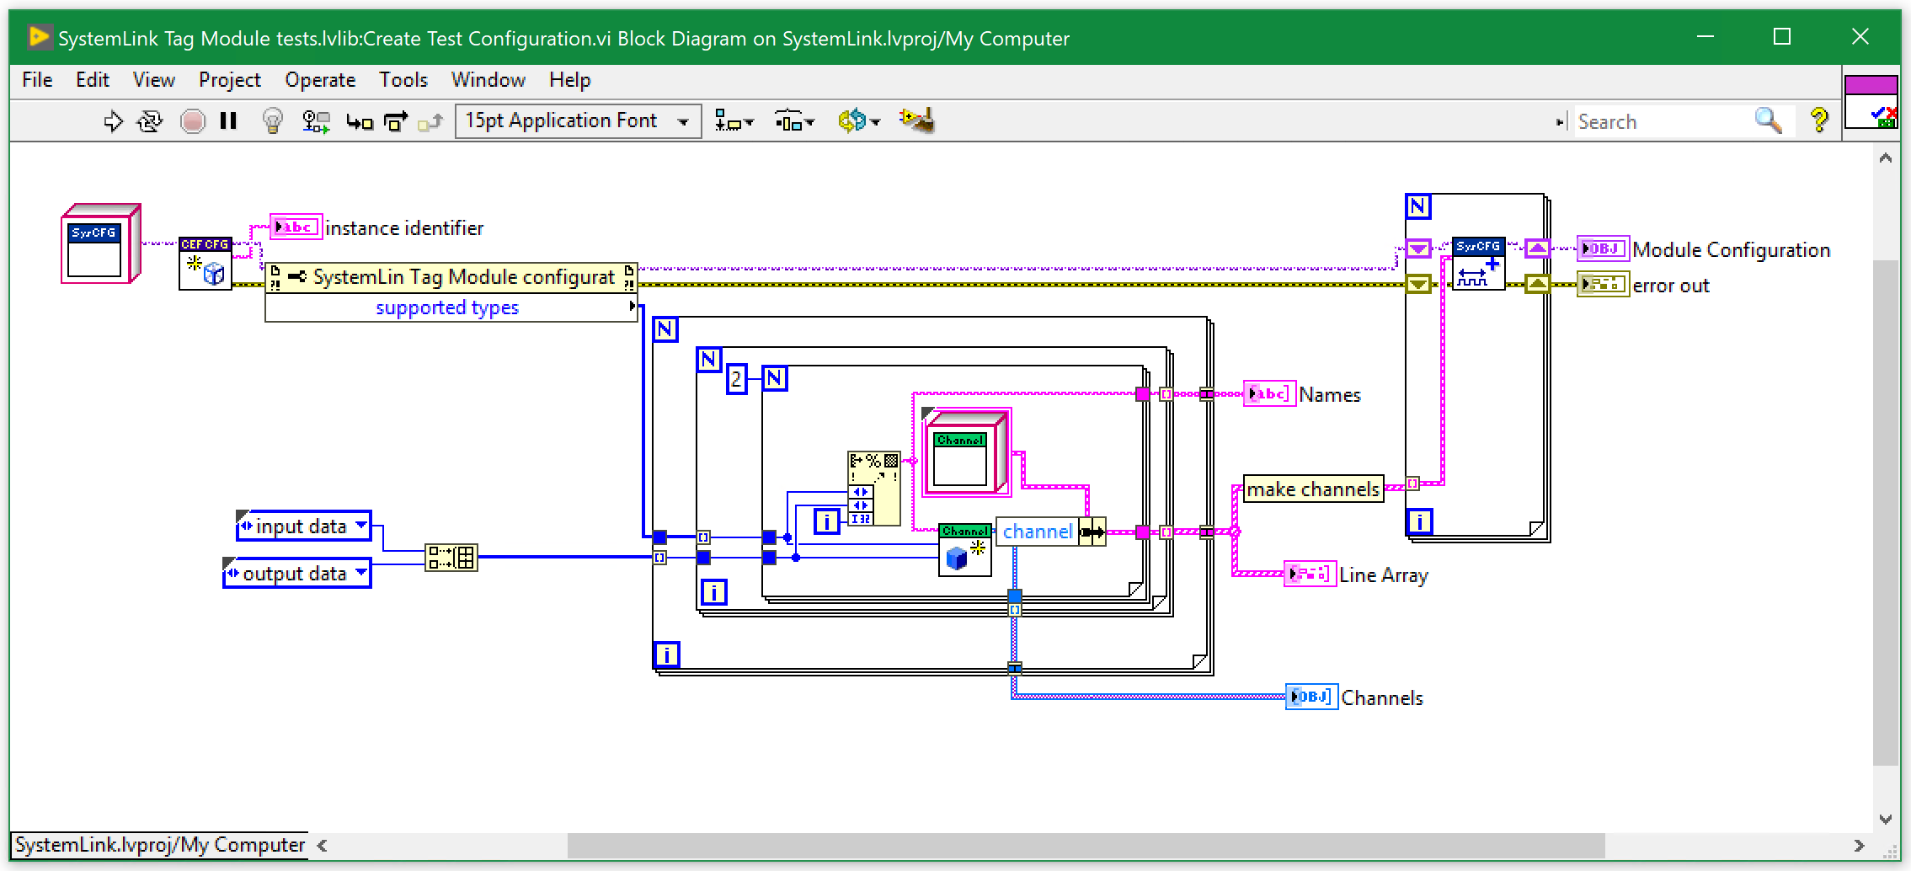
Create Test Configuration

Slide 25
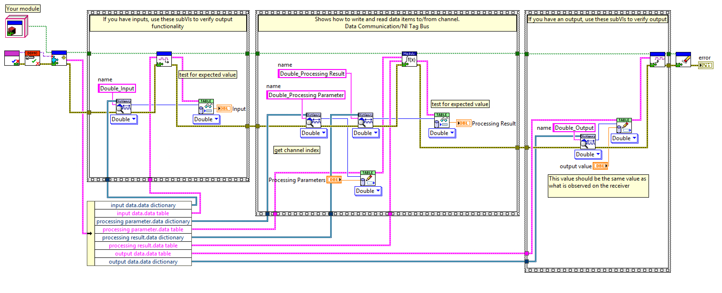
Runtime Test

Slide 26
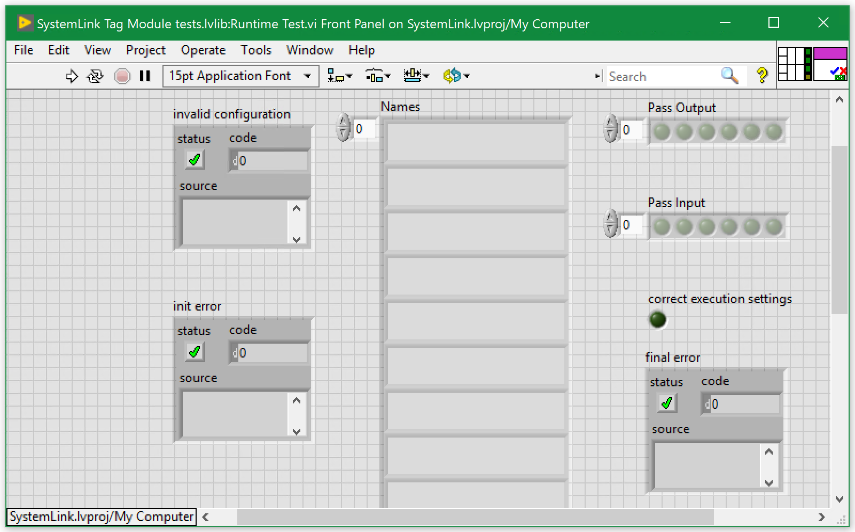
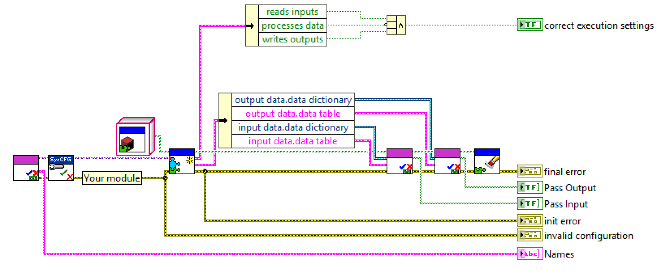
System Link Runtime Test

Slide 27
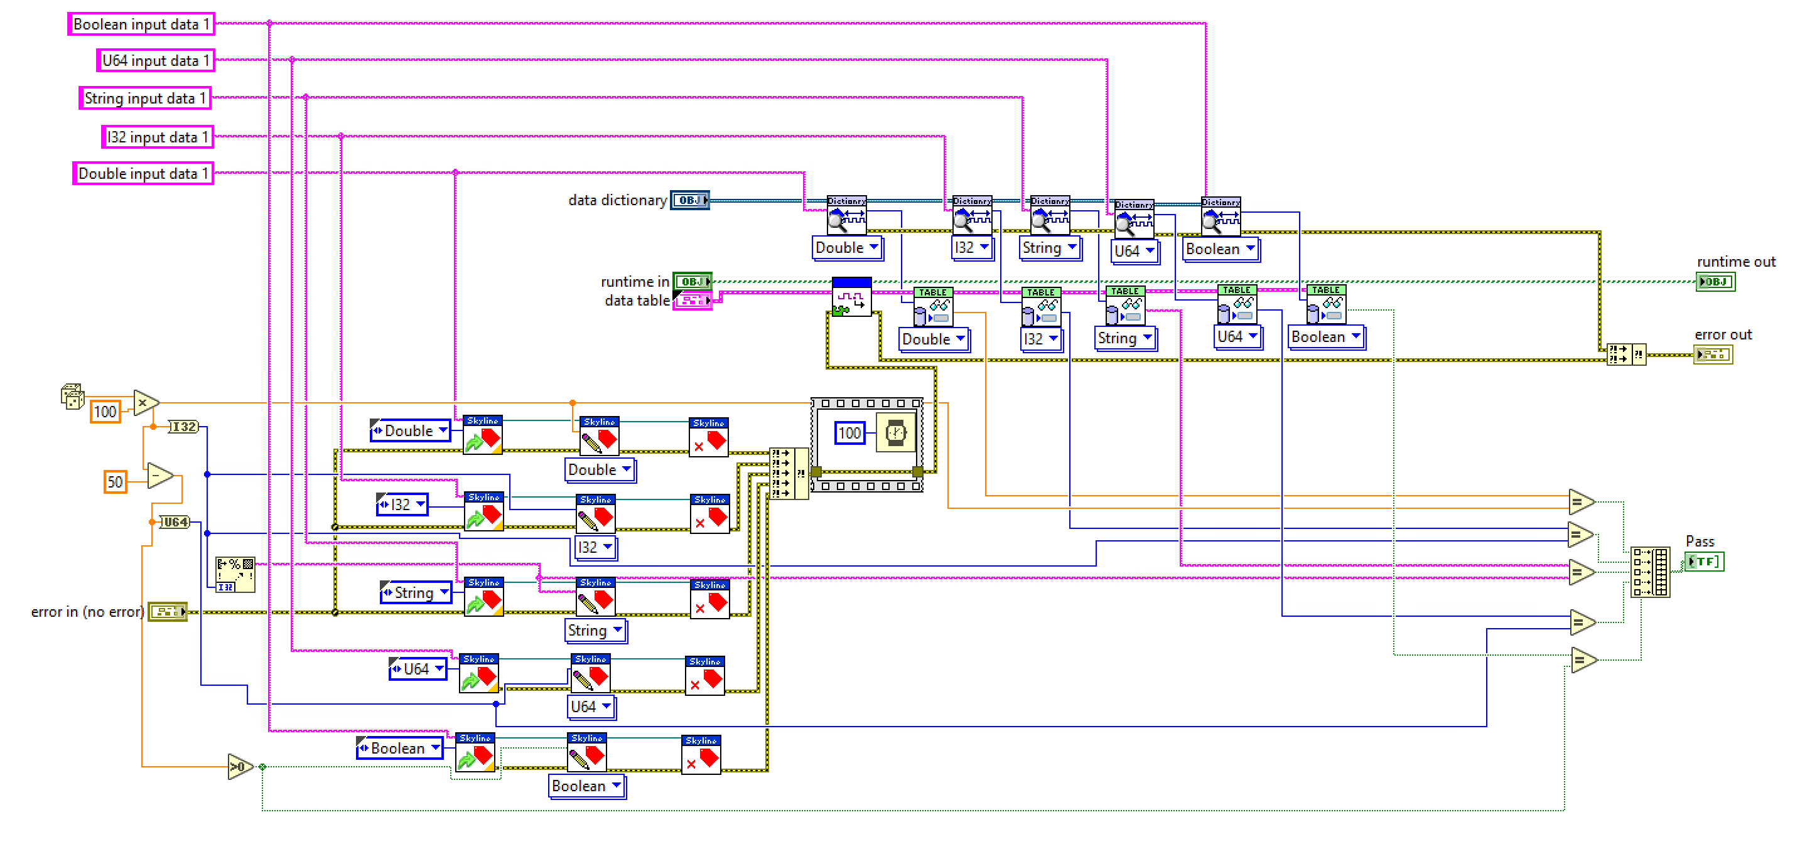
Read Test from the Runtime test.

Slide 28
Set Value for tags
Execute input of the module
Compare values read
Against Expected Values

Slide 29
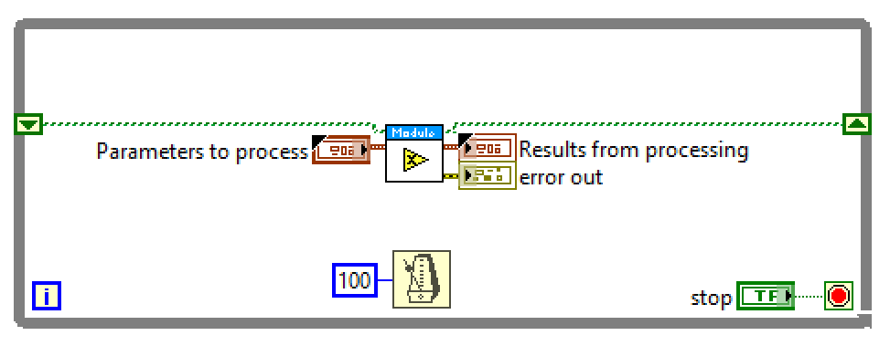
User Process Test

Slide 30
General Guidelines and Tips

Slide 31
Requirements
It is impossible to completely test a system.
You need requirements to know what you need to test.
Granular requirements make easier to figure adequate tests.

Slide 32
Tips for testing
You cannot test every possible input, parameter value, etc.
So you must think of a limited set of tests likely to expose bugs.
Think about boundary cases
positive; zero; negative numbers
right at the edge of an array or collection's size
Think about empty cases and error cases
0, -1, null; an empty list or array
test behavior in combination
maybe add usually works, but fails after you call remove
make multiple calls; maybe size fails the second time only

Slide 33
Tips for testing
Test one thing at a time per test method.
10 small tests are much better than 1 test 10x as large.
Each test method should have few (likely 1) assert statements.
If you assert many things, the first that fails stops the test.
You won't know whether a later assertion would have failed.
Tests should avoid logic.
minimize if/else, loops, switch, etc.
avoid try/catch
If it's supposed to throw, use expected= ... if not, let JUnit catch it.
Torture tests are okay, but only in addition to simple tests.

Slide 34
Tips for testing
Tests should be self-contained and not care about each other.
Constrained test order : Test A must run before Test B. (usually a misguided attempt to test order/flow)
Tests call each other : Test A calls Test B's method (calling a shared helper is OK, though)
Mutable shared state : Tests A/B both use a shared object. (If A breaks it, what happens to B?)

Slide 35
Didn’t we fix this bug before?
You are never done testing.
If you find a bug:
Create unit test before fixing the bug.
Fix the bug.
Run your test.
Notes:
During development new bugs will be found
You should create new unit test that test bugs.
You should create the test before the bug is fixed

Slide 36
Conclusions
You can NOT Test everything, so choose wisely.
You can NOT do proper testing without requirements
Testing adds overhead but reduces time spent in debugging.
You should do Unit Tests.
Use a Unit Test Framework.
You should automate your Unit testing.
Don’t Test In Production.
Make Time for testing.

Slide 37
More Resources
http://www.labviewcraftsmen.com/blog/do-you-unit-test
https://courses.cs.washington.edu/courses/cse331/11sp/lectures/slides/09-junit.ppt
http://www.cs.washington.edu/331/
Notes:
https://www.youtube.com/watch?v=e2Poh0bzcwk

